Slide 1

ADVANCED CANINE ANALYTICS (OPTIMIZING DOG HEALTH AND SERVICE SUITABILITY) WITH MACHINE LEARNING
CS4375 Project
Uma Rao
Net ID:UXR190000@UTDALLAS.EDU

Slide 2
Background As a dedicated dog lover, I've embraced this project to develop prototypes that not only analyze dog weights and service capabilities by breed but also pave the way for real-world applications, enhancing the efficacy and well-being of service dogs across various sectors.
Objective Develop machine learning prototypes to accurately predict dog weight by breed and assess their suitability for specific service roles, enhancing both canine welfare and service effectiveness.
Rationale behind Opting to study two Use Cases
The rationale behind choosing two distinct use cases—one focusing on regression and the other on classification—is to demonstrate the comprehensive capability of machine learning. This approach highlights how ML can handle both quantitative data for precise measurements and categorical data for decision-making, effectively showcasing the versatility of ML in solving varied and complex problems in canine care and service optimization.
What are the Key Machine Learning Prototypes?
DogWeightRegressionEvaluator:
Predict dog weight using multiple regression models based on breed and additional attributes.
DogServiceRatingClassifier:
Assess suitability of dogs for specific service roles through a Random Forest classification model.
DogSynDataGenerator:
Create synthetic data that replicates real-world canine datasets to train and validate models.
Why Synthetic Data?
Generated due to a lack of specific real-world datasets, enabling robust model testing and the simulation of rare scenarios.

Slide 3
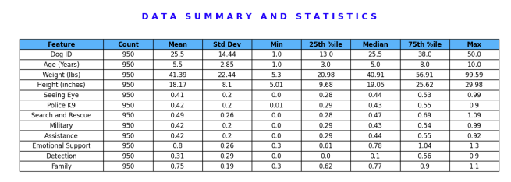
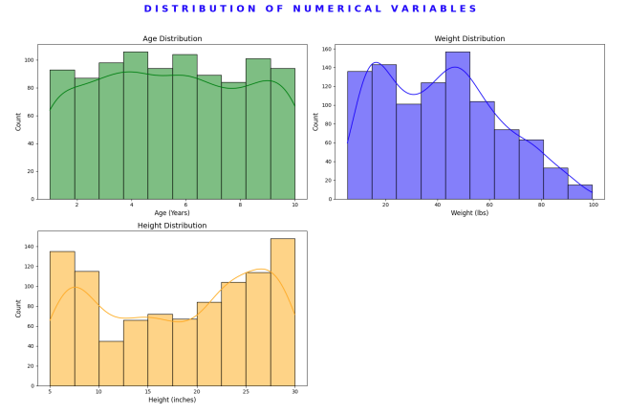
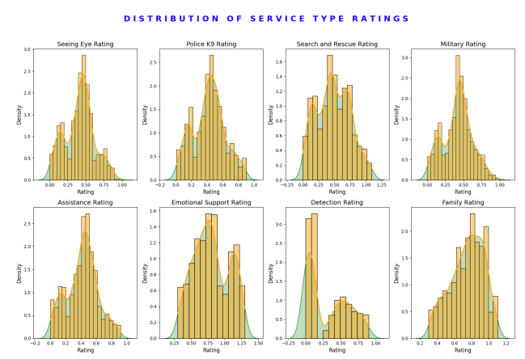
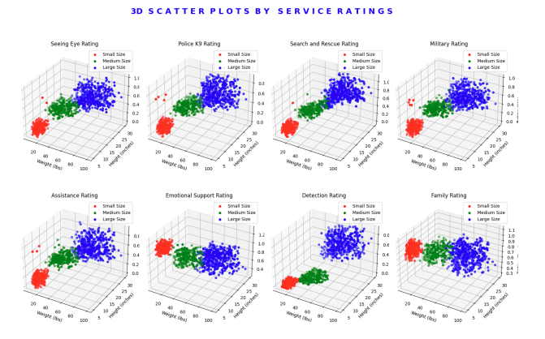
Inputs: Synthetic Data Generation and Data Analysis
Step | Detail
1. Generate Dog Breeds | Small Breeds (5): B-S1 to B-S5 Medium Breeds (5): B-M1 to B-M5 Large Breeds (9): B-L1 to B-L9
2. Generate Age | All Breeds: 1 to 10 years
3. Calculate Weight | Small: 10 – 30 lbs Medium: 31 – 60 lbs Large: 61 – 100 lbs
4. Calculate Height | Small: 5 – 10 inches Medium: 11 – 20 inches Large: 20 – 30 inches
5. Assign Service Suitability | Small: High 'Emotional Support' & 'Family', low for others Medium: Moderate to high 'Emotional Support' & 'Family', average for rest Large: Even distribution across all services
6. Adjust Ratings | Random variability to simulate real-life anomalies
7. Variable Data Volumes | Diverse and representative sample for each breed
Healthy Diversity: Normal Distributions in Dog Data
Versatile Services: Unveiling Dog Population Capabilities
Size Matters: Unraveling Service Suitability Complexity

Slide 4
Inputs: Synthetic Data Analysis
Healthy Diversity: Normal Distributions in Dog Data
Versatile Services: Unveiling Dog Population Capabilities
Size Matters: Unraveling Service Suitability Complexity
Notes:
Feature Correlation Analysis: The data showcases strong correlations between physical features (weight, height) and service type ratings, indicating that these attributes are significant predictors in the suitability models for various service roles.
Distribution Insights: The normal distribution of age, weight, and height metrics suggests robust feature engineering and data normalization processes, ensuring the ML models are trained on high-quality, representative data.
Predictive Model Application: The 3D scatter plots reveal distinct clusters based on service ratings, emphasizing the effectiveness of classification algorithms in segmenting data and predicting optimal service roles based on breed and physical characteristics.

Slide 5
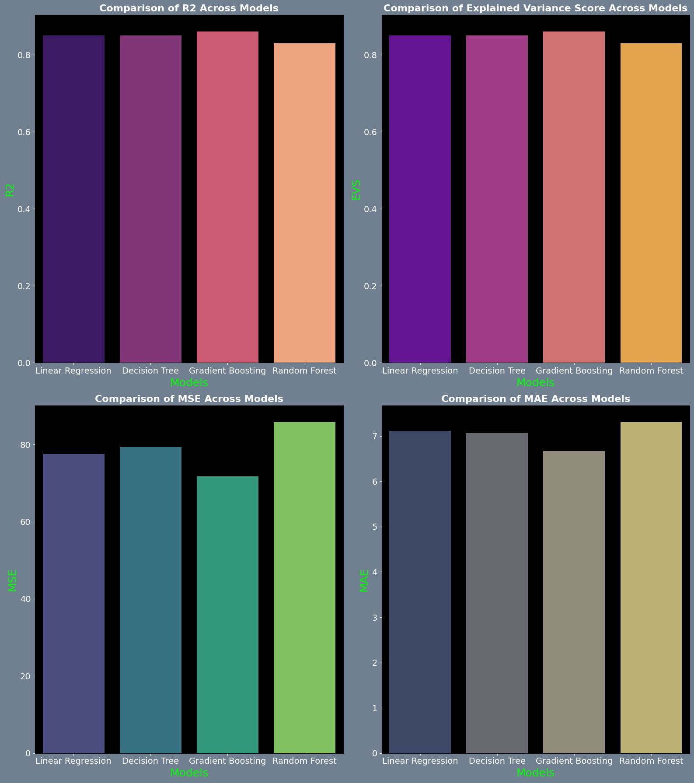
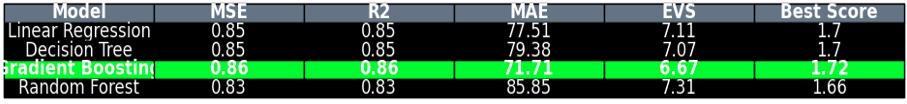
Use Case 1 (Regression): Regression Model Evaluations for Best Fit
Objective
Evaluate dog weight using regression models based on features like breed. Uncover insights into factors influencing dog weight. Provide recommendations for weight prediction
Data Preparation
Loaded synthetic dog dataset with breed, age, and weight information. Split data into training and testing sets
Regression Model Evaluation and Best Fit Selection
Assessed 4 regression models:
Linear Regression
Decision Tree
Gradient Boosting
Random Forest
Used metrics:
MSE
R-squared
MAE
Explained Variance Score
Gradient Boosting selected as best performing model

Slide 6
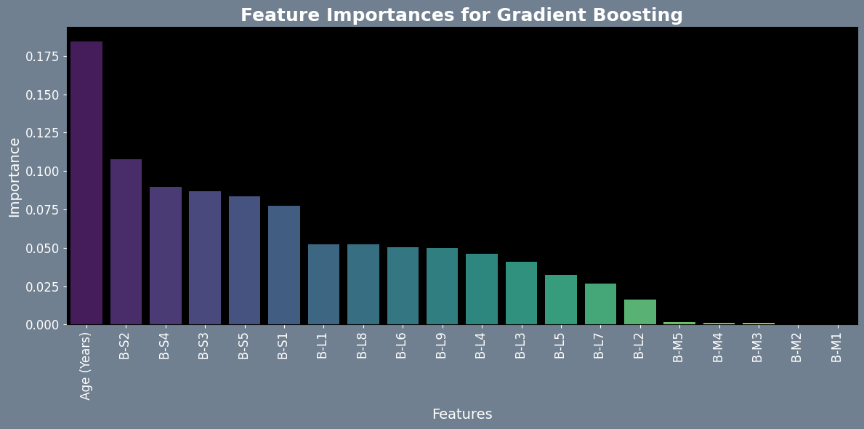
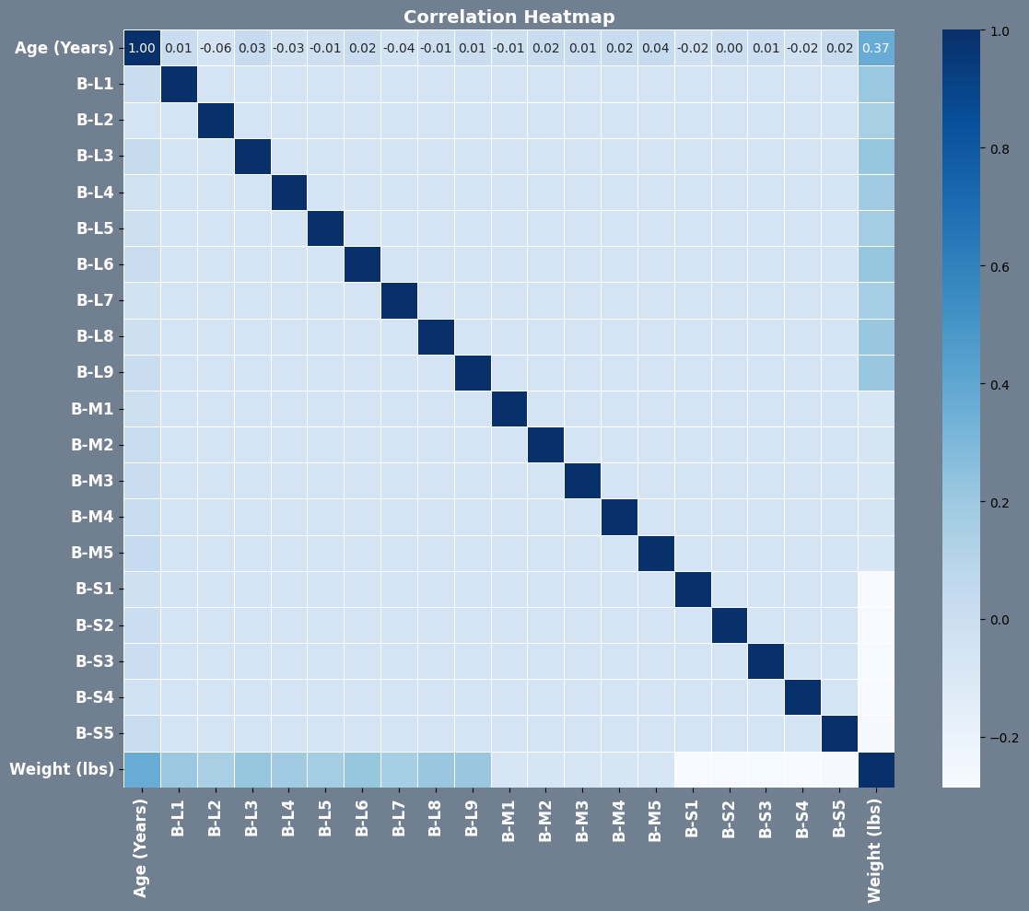
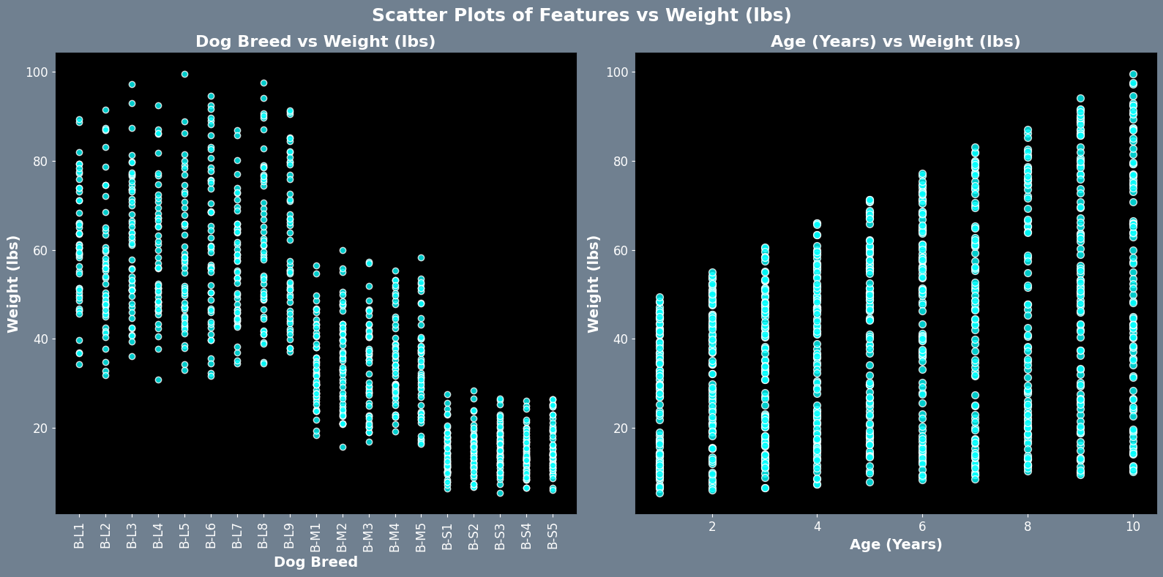
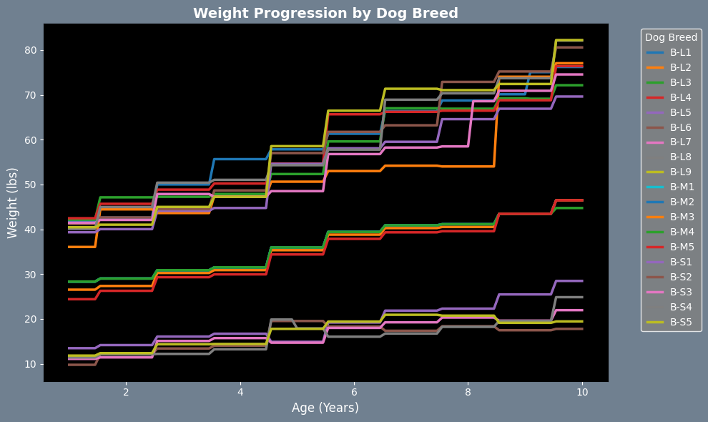
Use Case 1 (Cont.):Best Fit Model Evaluation and Future Improvements
Visuals for Best Fit Model - Gradient Boosting
Feature Importance: Analyzed importance of features like breed and age in predicting weight
Correlation Heatmap: Visualized relationships between features and target variable (weight)
Scatter Plots: Plotted individual features vs weight to understand distributions and correlations
Model Predictions
Weight Progression by Breed shows how dog weight changes with age for different breeds
Conclusion:
The Gradient Boosting model showed strong predictive capabilities, supported by insights from feature importance, scatter plots, and correlation heatmaps. The results, including weight progression by breed and age, present a promising commercial opportunity. However, refinement opportunities exist:
Explore strategies to reduce Mean Squared Error.
Utilize techniques to address high multicollinearity.
Adjust model complexity and consider additional features for improvement.
Fine-tune parameters for optimal performance.

Slide 7
Use Case 1 (Cont.):Best Fit Model charts

Slide 8
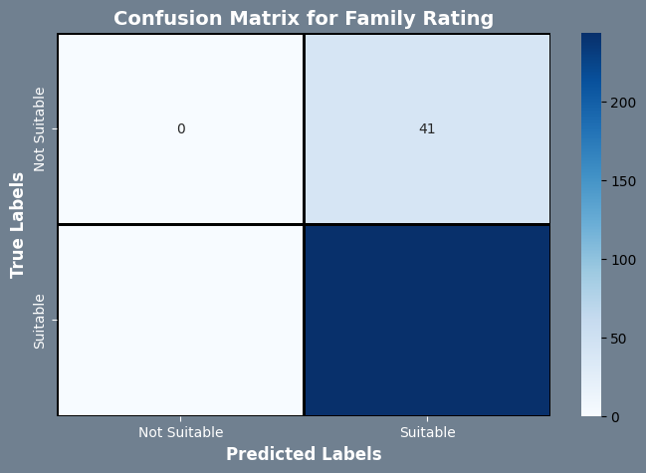
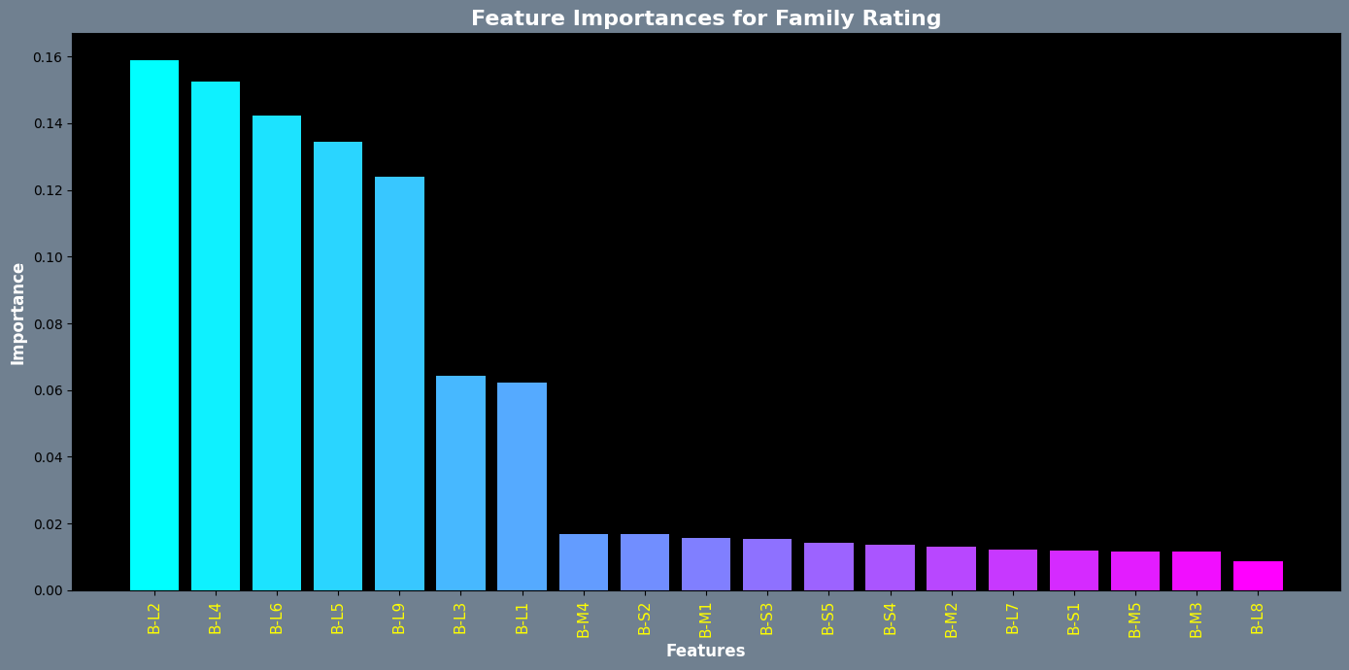
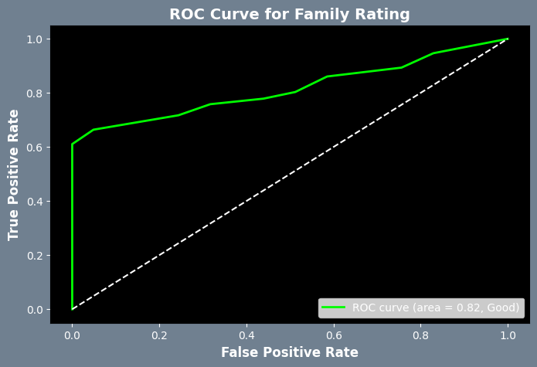
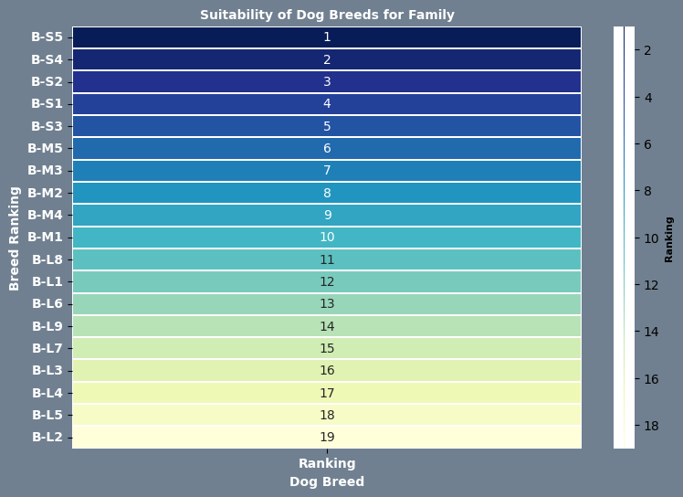
Use Case 2 (Classification) : Dog Service Rating classifier
Objective
Predict the suitability of different dog breeds for specific service roles based on various features.
Model
The Dog Service Rating Classifier utilizes a Random Forest Classifier to predict the suitability of dog breeds for specific service roles.
Insights include
Feature Importance
Confusion Matrix
ROC Curve
Service Suitability Ranking Table:
A heatmap visualizes the suitability rankings of different dog breeds for the specific service role, offering a clear comparison and ranking based on their predicted ratings.
Conclusion:
Demonstrates strong predictive capabilities
Further refinement to enhance applicability in diverse scenarios

Slide 9
Use Case 2 (Classification) : Dog Service Rating classifier Plots

Slide 10
Closing Remarks
Lessons Learned
Explored projects, focused on neural networks but changed the track.
Managed diverse data, ML adaptability.
Struggled with synthetic data realism.
Learned from setbacks, non-linear ML progress.
Prototyping key for early model insights.
Commercial Viability
further exploration and potential expansions, these prototypes could be adapted for real-world applications.
Future Expansions:
Behavioral Insights: Incorporate behavioral data to refine suitability assessments.
Lifestyle Matching: Customize models to account for owner lifestyle, optimizing dog-owner pairing. Extended Applications:
Extended Applications:
Veterinary Systems Integration: Employ regression models for proactive dog weight management.
Service Dog Certification: Utilize classifiers to streamline the certification of service dogs.

